Slide 1
FRESHLENS
Sprint 4 - TEAM-4 Sierra

Slide 2
AGENDA
Project Review
Team members
MVP
Technologies
Algorithms
Diagrams
Sprint 3 recap
Product and Sprint 4 Backlog
Sprint 2 and Sprint 3 summary and burndown chart
Metrics
Retrospective
Project demo
Github
App demo

Slide 3
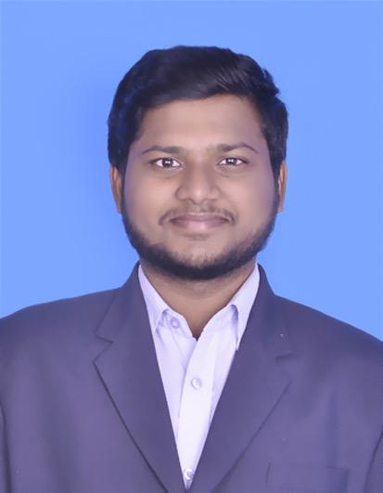
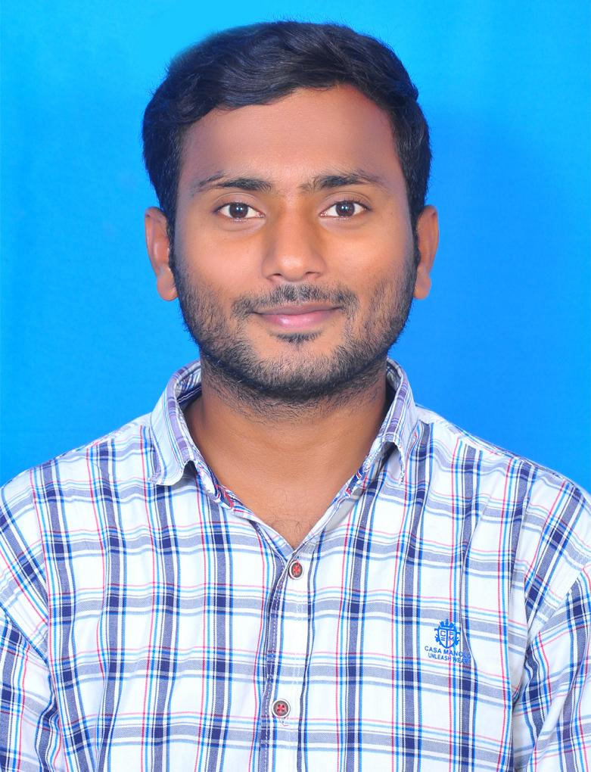
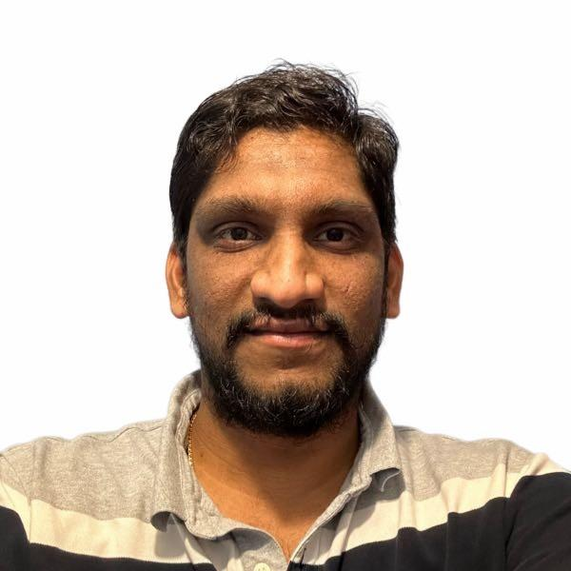
TEAM MEMBERS
Chandu Pentela Project Manager / Backend Developer
Jaya Venkata Vara Sai Prakash Perumalla Backend Developer
Banoth Ashok Backend Developer

Slide 4
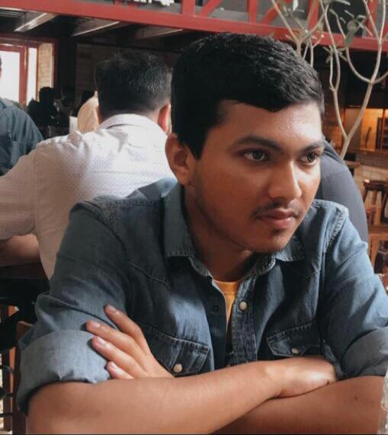

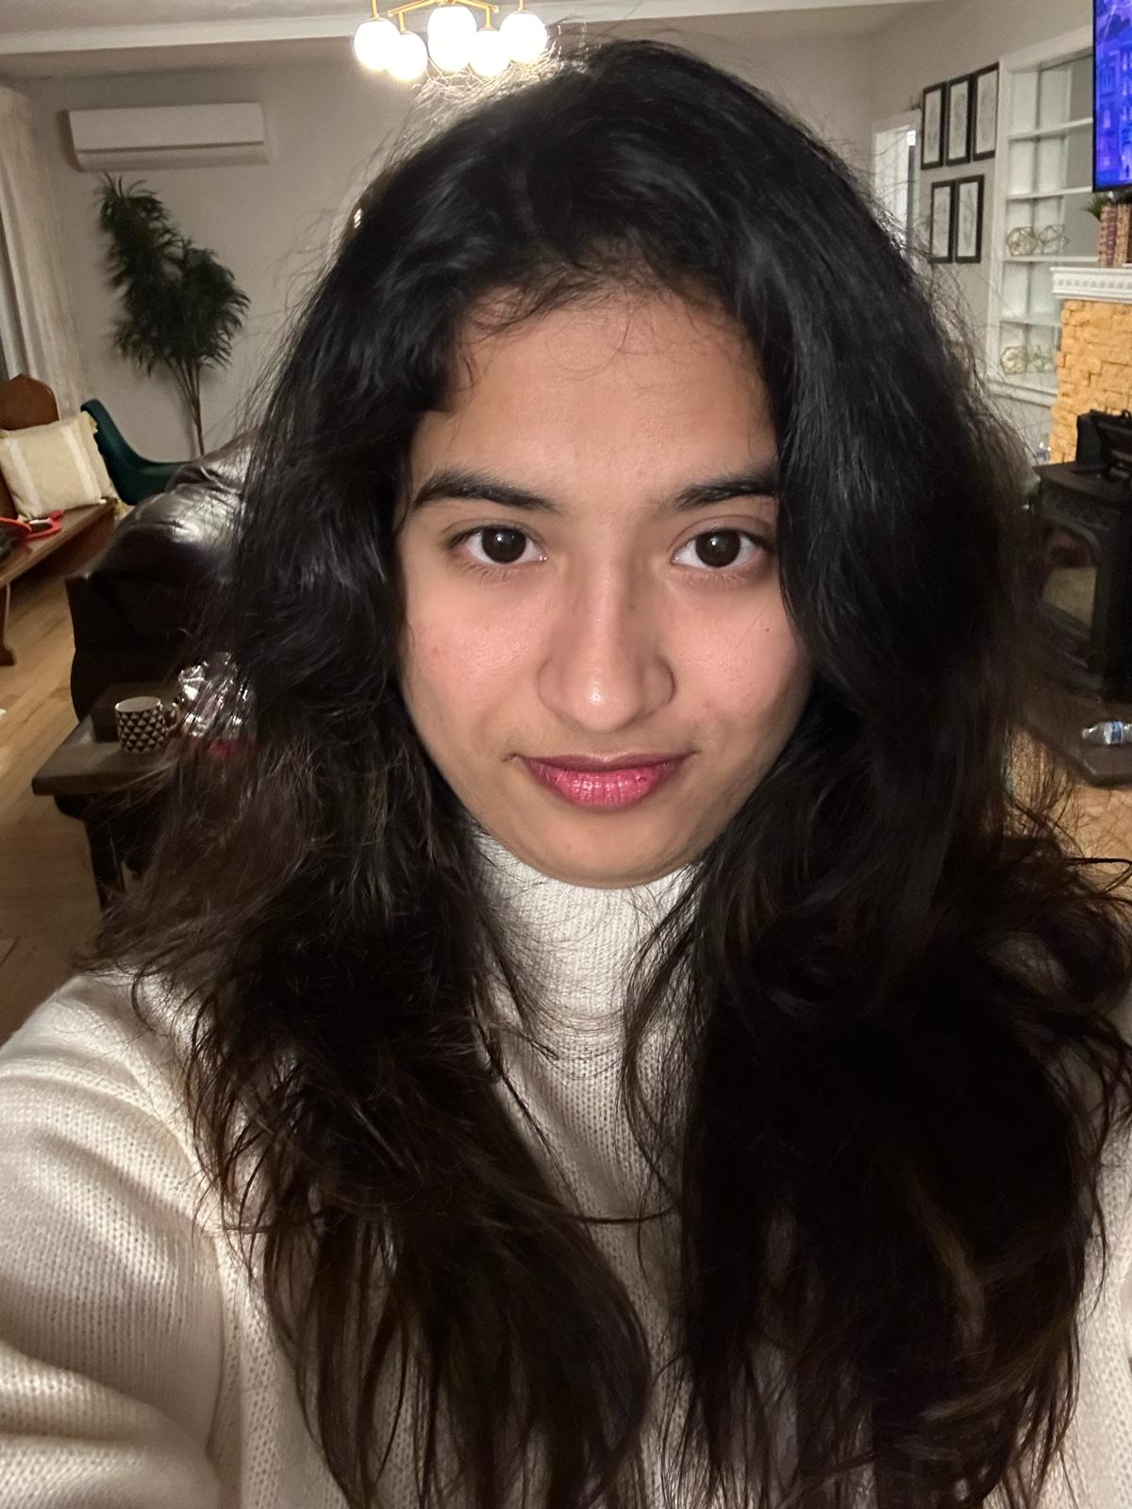
TEAM MEMBERS
Ashish Padma Machine Learning Engineer
Poojitha chinthala Machine Learning Engineer
Sushmitha Reddy Poddaturu Machine Learning Engineer

Slide 5

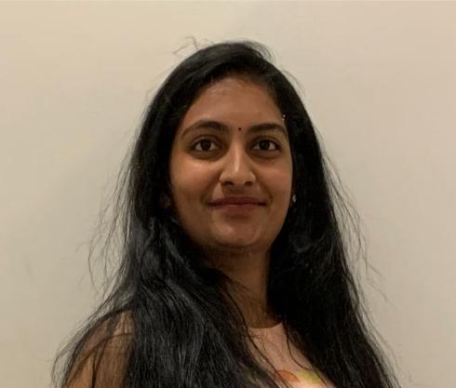
TEAM MEMBERS
Satish kumar reddy indla Developer
Aishwarya Kongari
Developer

Slide 6
Changes based on Professor feedback
Changes in MVP
Adding Historical Velocity
Changing Table layouts

Slide 7
PROBLEM STATEMENT
Many individuals want to maintain a healthy diet but they find it challenging to keep track of their diet and analyse it. The traditional way where keep logging food intake often time and it is prone to inaccuracies, which leads to poor diet choices and even demovitates the individual.
There needs to be a way for a more intuitive and efficient way to understand the nutritional values of fruits and easy to keep track of the intake. Which makes individuals to take healthy diet options.

Slide 8
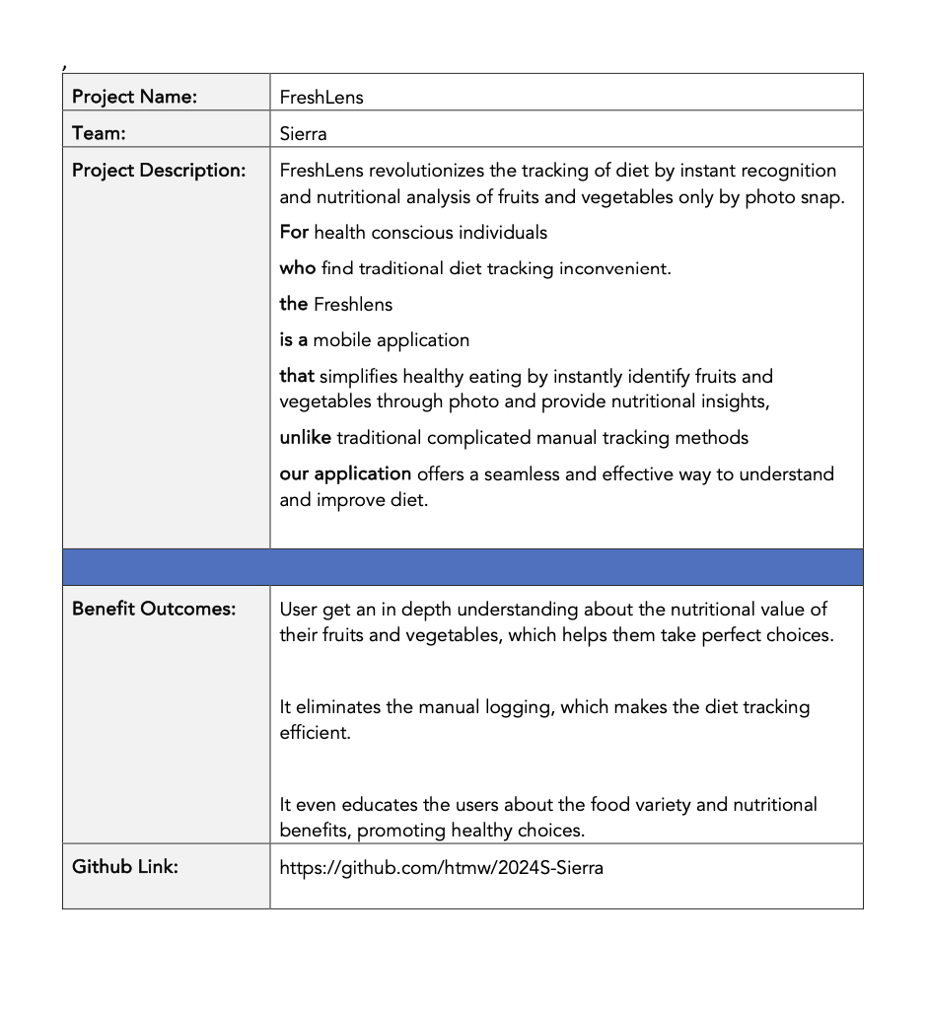
PROJECT DESCRIPTION

Slide 9
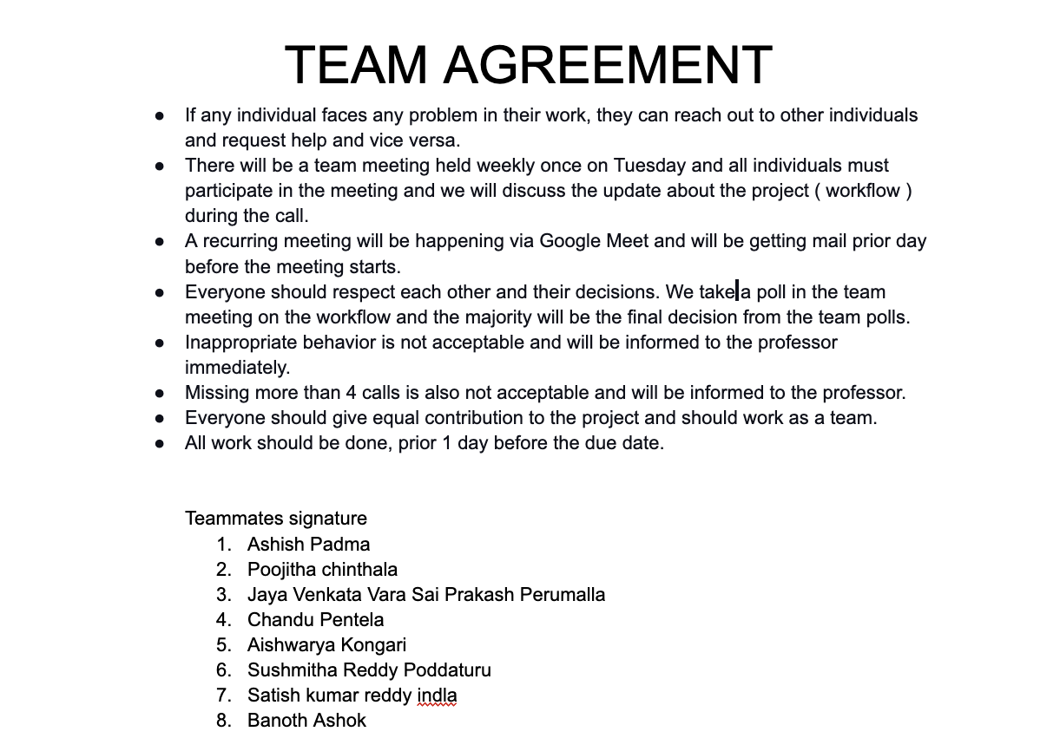
TEAM WORKING AGREEMENT

Slide 10
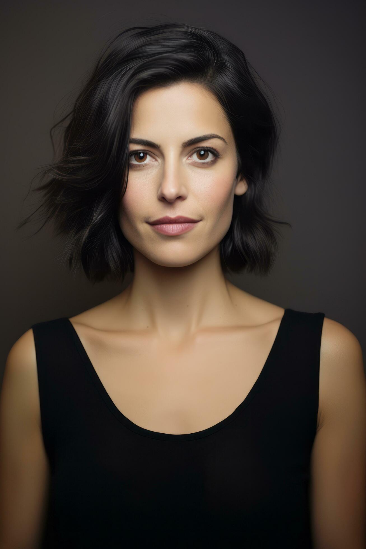
PERSONAS
Name: Emily
Age: 30
Occupation: Marketing Analyst
Interests: Yoga, cooking, and reading health blogs
Goals: Maintain a balanced diet
Challenges: Struggles to find accurate nutritional info for fresh produce
How Your App Helps: FreshLens offers instant nutritional content, supporting her balanced diet and culinary exploration.

Slide 11
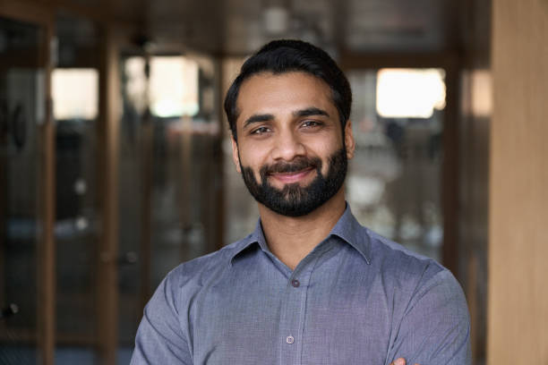
PERSONAS
Name: Alex
Age: 35
Occupation: Software Engineer
Interests: Tech gadgets, hiking, fast cooking
Goals: Eat healthily despite a busy schedule
Challenges: Has limited time for meal prep and nutrition tracking
How Your App Helps: FreshLens easily fits in busy lifestyle, it's designed for healthy eating with quick scan

Slide 12
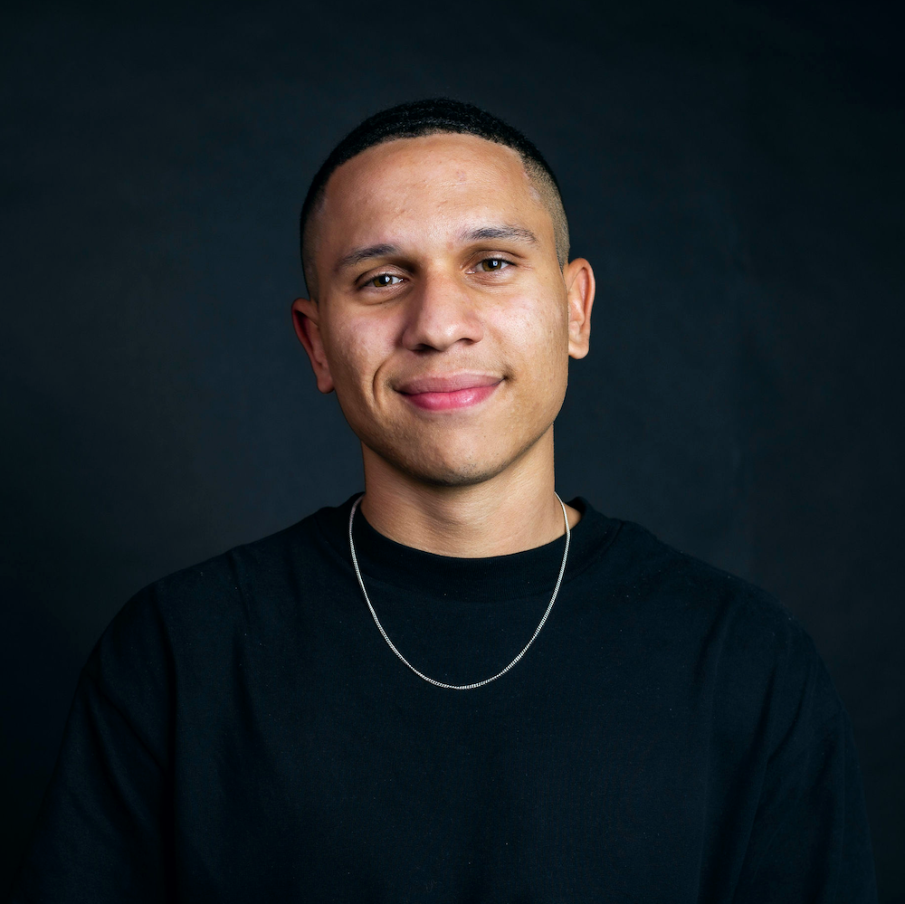
PERSONAS
Name: Jordon
Age: 26
Occupation: Personal Trainer
Interests: Gym workouts, sports nutrition, bodybuilding
Goals: Optimize diet for muscle gain and performance
Challenges: Needs precise macro and micro intake from natural foods
How Your App Helps: FreshLens helps in tracking nutritional values, enhancing his meal planning.

Slide 13
Minimum Viable Product (MVP)
Photo Food Logging: Effortless food tracking with AI-powered photo recognition. No manual entry required.
Intuitive Design: Clean, modern UI for seamless dietary monitoring. Delightful user experience.
Nutritional Insights: Detailed breakdown of nutrients, macros, and calories for informed diet choices.
Secure Profiles: Robust authentication for personalized accounts and data privacy.
Customizable Plans: Tailored profiles for dietary preferences, restrictions, and goals.
Weekly Analytics: Comprehensive weekly reports for diet pattern analysis and progress tracking.

Slide 14


Technologies - Frontend
We will be using React native expo for developing UI for the mobile application and expo is wrapper around react native and it makes prototyping faster.

Slide 15




Technologies - Backend
We will be using node js and fastapi for backend and mongodb as database and its nosql database and even firebase for Authentication and storing images using firebase cloud storage.

Slide 16

Technologies - Machine Learning
We will be using tensorflow to perform machine learning tasking and tensorflow is deep learning framework and it will be used for implementing CNN algorithm.

Slide 17

TECH STACK
Figma is used for designing of the application and sharing the application ideas on how it should look like.

Slide 18
Machine Learning Algorithm
CNN Architecture Algorithm .
In CNN Algorithm. we use DenseNet121.
The DenseNet model is trained using fruits and vegetables dataset. Due to its efficiency and high accuracy, DenseNet model effectively learns from the data and accurately identifies objects.

Slide 19
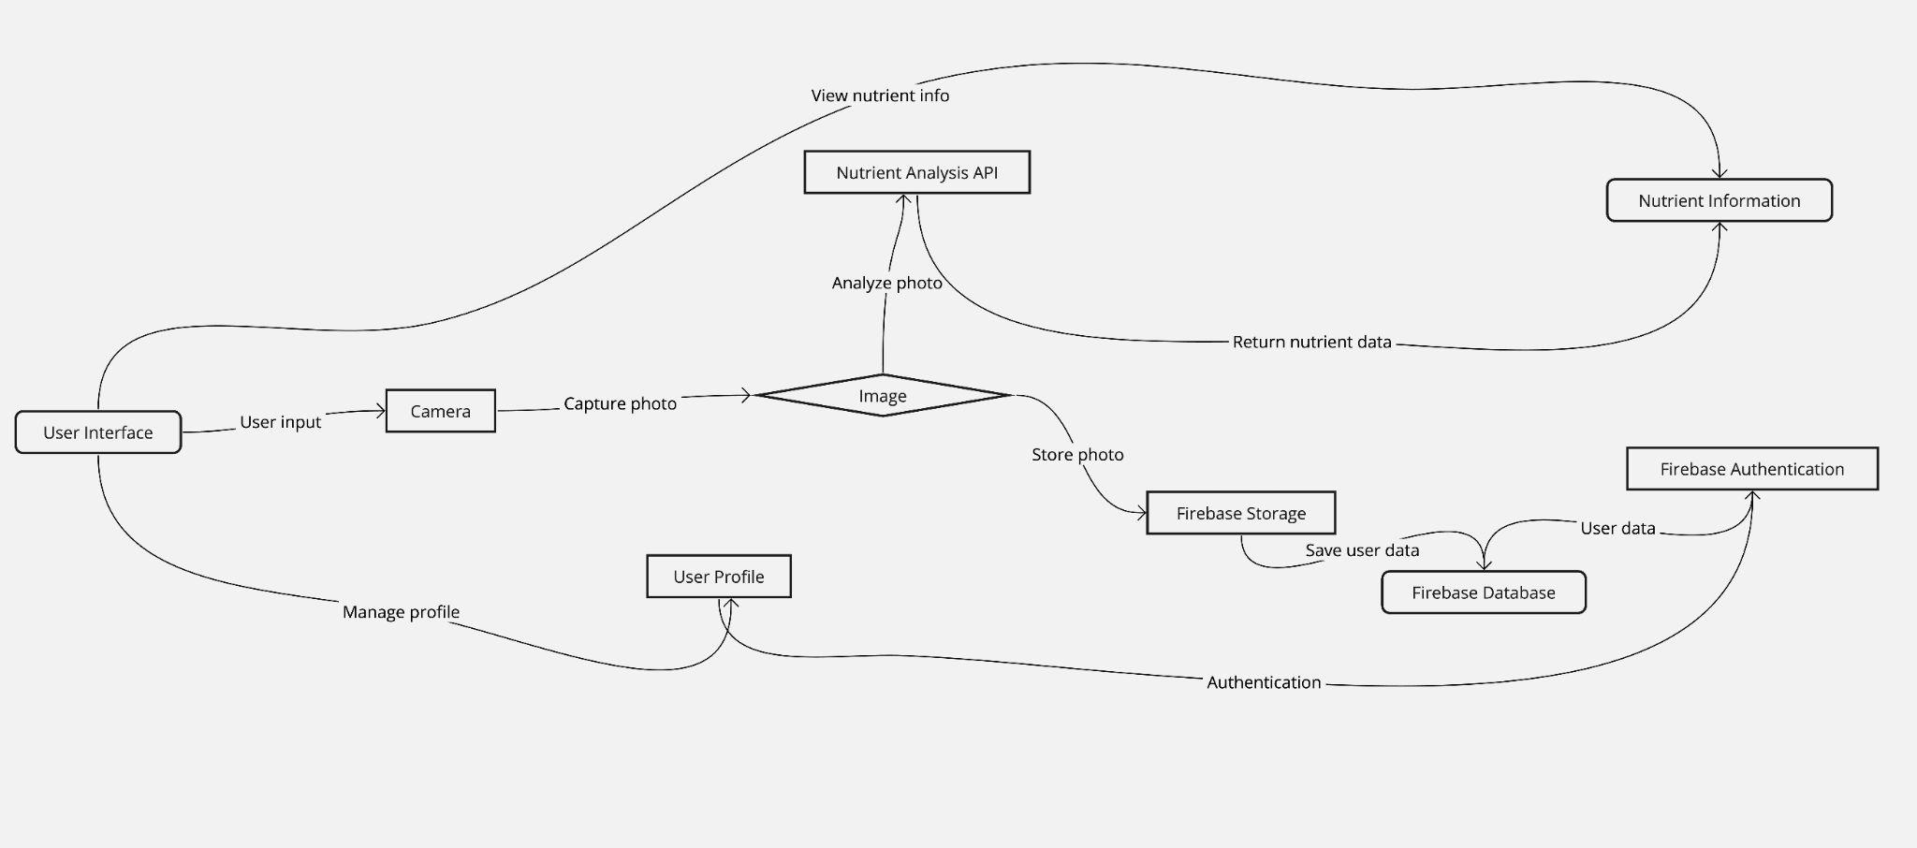
Conceptual Architecture Diagram

Slide 20
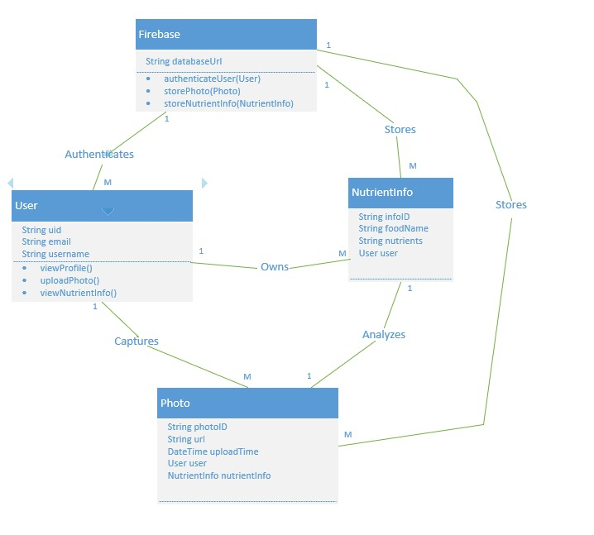
Class Diagram

Slide 21
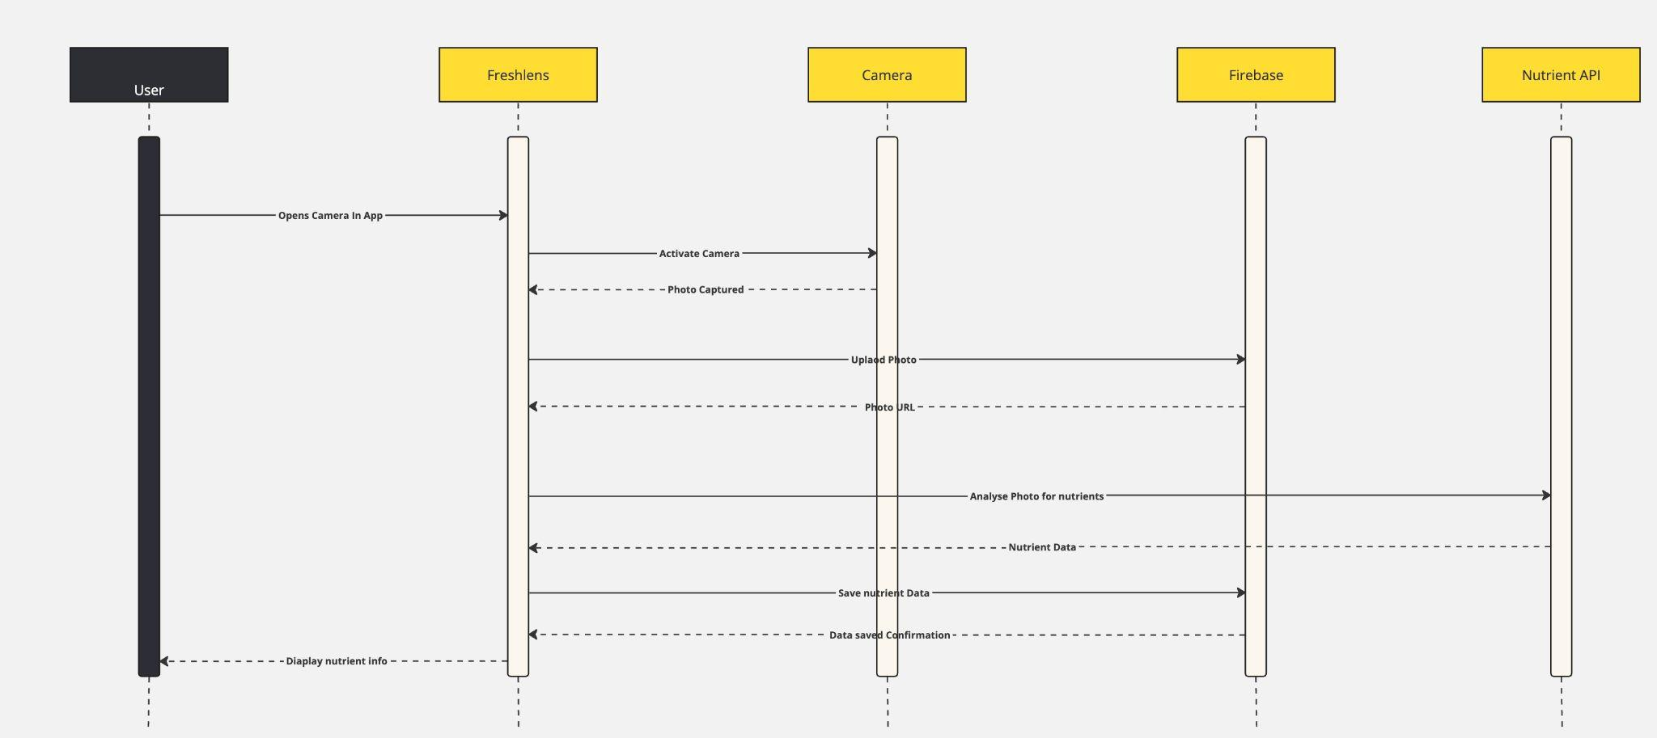
Sequence Diagram

Slide 22
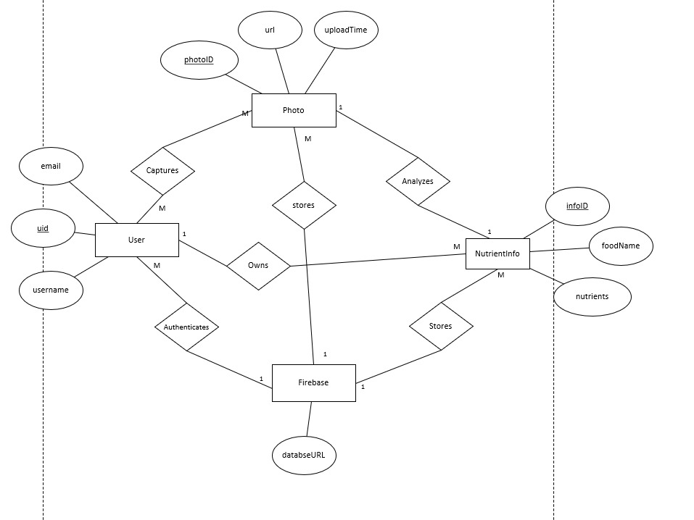
Entity Relationship Diagram

Slide 23
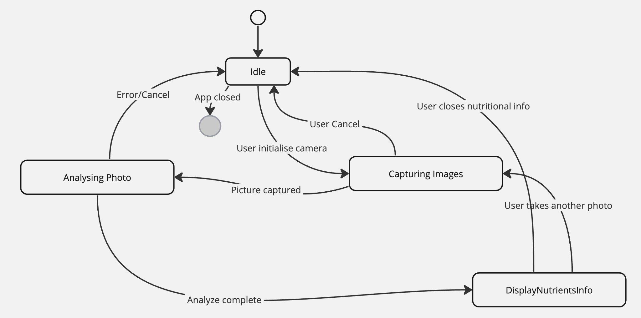
State diagram

Slide 24
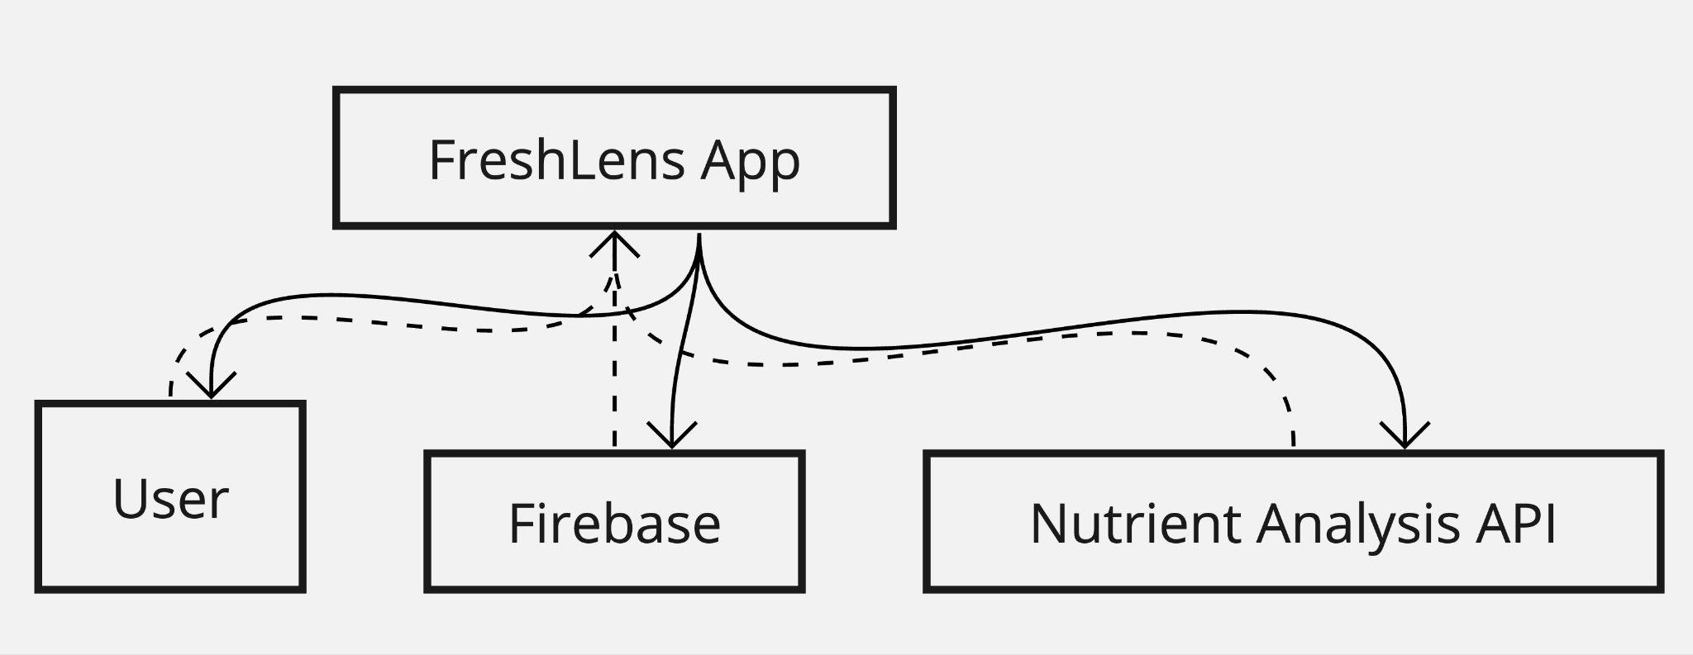
Context Diagram

Slide 25
Sprint 3 Recap
Image recognition and identify the image.
Integration with the API for getting nutritional data
Saving the data in favorites screen
Database created and stored
23 Points
100% completed

Slide 26
Product Backlog
S.no | Feature | User Story | Points
1 | Image capture | As a user, I want to capture images of fruits | 5
2 | User Profile | As a user, I want to view a profile screen | 3
3 | Favorites | As a user, I want to have a favorite screen to save my preferred fruits | 5
4 | Fruit Recognition | As a user, I want the app to recognize fruits from the images I capture using ML | 13
5 | Nutritional Info | As a user, I want to view nutritional information for the recognized fruits | 3
6 | Intake Logging | As a user, i want to log my daily fruit intake | 2
7 | Database Storage | As a user, I want the logged fruit intake to be stored in a database | 5
8 | Fruit Reviews | As a user, I want to rate and review the fruits I consume | 8
9 | Multilingual Support | As a user, I want the app to provide multilingual support | 3
10 | Recipe Sharing | As a user, I want to contribute my own fruit based recipes to the app | 8
11 | Challenges | As a user, I want to participate in fruit consumption challenges | 13
12 | Intake Reminders | As a user, I want to receive reminders to log my fruit intake | 2

Slide 27
User Stories and Acceptance Criteria
S.no | Feature | User Story | Points
1 | The app should provide an option to capture or select fruit images, and display the captured/selected image.
 | Image Capture | As a user, I want to capture images of fruits. | 5
2 | The app should have a dedicated profile screen where users can view and update their information.
 | User Profile | As a user, I want to view a profile screen. | 3
3 | The app should have a favorites screen for adding, removing, and persisting favorite fruits across sessions.
 | Favorites | As a user, I want to have a favorites screen to save my preferred fruits. | 5

Slide 28
User Stories and Acceptance Criteria
S.no | Feature | User Story | Points
4 | The app should implement ML or integrate with a fruit recognition API to accurately identify fruits from user images and provide feedback.
 | Fruit Recognition | As a user, I want the app to recognize fruits from the images I capture using ML. | 13
5 | The app should have access to a database or API to display nutritional information (e.g., calories, vitamins, minerals) for recognized fruits.
 | Nutritional Info | As a user, I want to view nutritional information for the recognized fruits. | 3
6 | The app should allow users to log their fruit intake, including quantity/serving size, and maintain a log or history.
 | Intake Logging | As a user, I want to log my daily fruit intake. | 2

Slide 29
User Stories and Acceptance Criteria
S.no | Feature | User Story | Points
7 | The app should have a database or storage mechanism to persist and retrieve the user's logged fruit intake across sessions and devices.
 | Database Storage | As a user, I want the logged fruit intake to be stored in a database. | 5
8 | The app should enable users to rate and review fruits, and display their ratings and reviews for each fruit.
 | Fruit Reviews | As a user, I want to rate and review the fruits I consume. | 8
9 | The app should support multiple languages, allow users to select their preferred language, and display all content in the selected language.
 | Multilingual Support | As a user, I want the app to provide multilingual support. | 3

Slide 30
User Stories and Acceptance Criteria
S.no | Feature | User Story | Points
10 | The app should provide a way for users to submit their own fruit-based recipes, including details like ingredients, instructions, and optionally, images or videos, and display a collection of user-contributed recipes.
 | Recipe Sharing | As a user, I want to contribute my own fruit-based recipes to the app. | 8
11 | The app should offer various fruit consumption challenges, allow users to join and participate, track progress, and provide rewards or recognition for completing challenges.
 | Challenges | As a user, I want to participate in fruit consumption challenges. | 13
12 | The app should allow users to enable reminders for logging fruit intake, set reminder frequency and timing, and send notifications or reminders accordingly.
 | Intake Reminders | As a user, I want to receive reminders to log my fruit intake. | 2

Slide 31
Sprint 2 Summary
S.no | Feature | User Story | Points
1 | The app should provide an option to capture or select fruit images, and display the captured/selected image.
 | Image Capture | As a user, I want to capture images of fruits. | 5
2 | The app should have a dedicated profile screen where users can view and update their information.
 | User Profile | As a user, I want to view a profile screen. | 3
3 | The app should have a favorites screen for adding, removing, and persisting favorite fruits across sessions.
 | Favorites | As a user, I want to have a favorites screen to save my preferred fruits. | 5

Slide 32
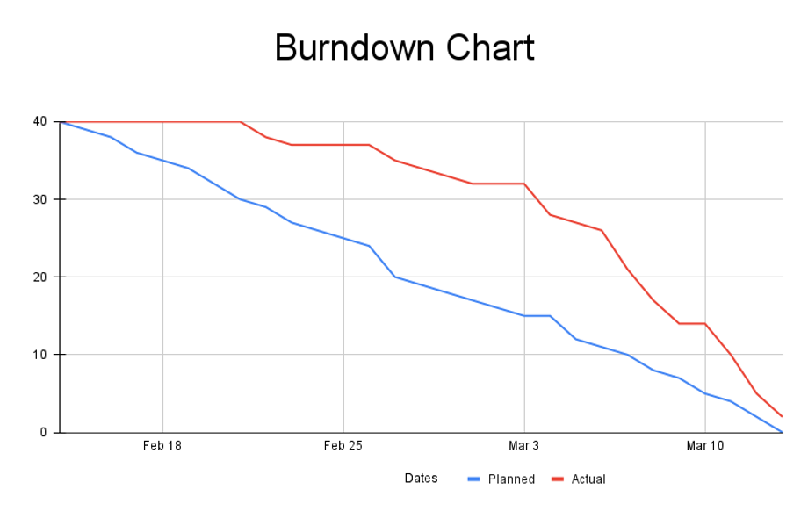
Sprint 3 Burndown chart

Slide 33
Sprint 3 Summary
S.no | Feature | User Story | Points
4 | The app should implement ML or integrate with a fruit recognition API to accurately identify fruits from user images and provide feedback.
 | Fruit Recognition | As a user, I want the app to recognize fruits from the images I capture using ML. | 13
5 | The app should have access to a database or API to display nutritional information (e.g., calories, vitamins, minerals) for recognized fruits.
 | Nutritional Info | As a user, I want to view nutritional information for the recognized fruits. | 3
6 | The app should allow users to log their fruit intake, including quantity/serving size, and maintain a log or history.
 | Intake Logging | As a user, I want to log my daily fruit intake. | 2
7 | The app should have a database or storage mechanism to persist and retrieve the user's logged fruit intake across sessions and devices.
 | Database Storage | As a user, I want the logged fruit intake to be stored in a database. | 5

Slide 34
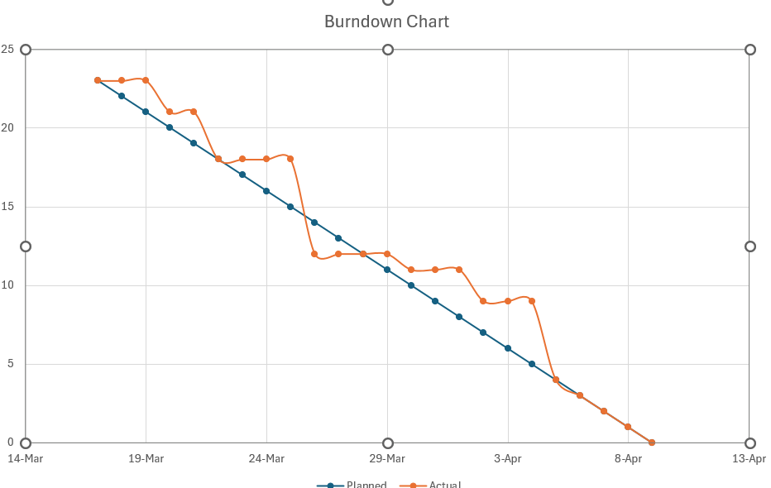
Sprint 3 Burndown chart

Slide 35
Sprint 4 Backlog
S.no | Feature | User Story | Points
8 | The app should enable users to rate and review fruits, and display their ratings and reviews for each fruit.
 | Fruit Reviews | As a user, I want to rate and review the fruits I consume. | 8
9 | The app should support multiple languages, allow users to select their preferred language, and display all content in the selected language.
 | Multilingual Support | As a user, I want the app to provide multilingual support. | 3
10 | The app should provide a way for users to submit their own fruit-based recipes, including details like ingredients, instructions, and optionally, images or videos, and display a collection of user-contributed recipes.
 | Recipe Sharing | As a user, I want to contribute my own fruit-based recipes to the app. | 8
11 | The app should offer various fruit consumption challenges, allow users to join and participate, track progress, and provide rewards or recognition for completing challenges.
 | Challenges | As a user, I want to participate in fruit consumption challenges. | 13
12 | The app should allow users to enable reminders for logging fruit intake, set reminder frequency and timing, and send notifications or reminders accordingly.
 | Intake Reminders | As a user, I want to receive reminders to log my fruit intake. | 2

Slide 36
Test Cases
Test Case ID | User Story ID | Feature | Description | Steps | Expected Result | Status
TC1 | 8 | Fruit Reviews | Add Fruit Review | Login, navigate to fruit review section, choose a fruit, submit a review and rating. | Review and rating are saved and displayed for that fruit. | Pass
TC2 | 8 | Fruit Reviews | Display Reviews | Navigate to a fruit detail page. | All reviews and ratings for that fruit are displayed. | Pass
TC3 | 8 | Fruit Reviews | Review Input Validation | Attempt to submit an empty review or an invalid rating. | Error message is displayed and review is not submitted. | Pass
TC4 | 9 | Multilingual Support | Change Language | Go to settings, select a different language. | All app content updates to reflect the selected language. | Pass
TC5 | 9 | Multilingual Support | Language Persistence | Change language, close and reopen the app. | App retains the selected language setting. | Pass

Slide 37
Test Cases
Test Case ID | User Story ID | Feature | Description | Steps | Expected Result | Status
TC1 | 8 | Fruit Reviews | Add Fruit Review | Login, navigate to fruit review section, choose a fruit, submit a review and rating. | Review and rating are saved and displayed for that fruit. | Pass
TC2 | 8 | Fruit Reviews | Display Reviews | Navigate to a fruit detail page. | All reviews and ratings for that fruit are displayed. | Pass
TC3 | 8 | Fruit Reviews | Review Input Validation | Attempt to submit an empty review or an invalid rating. | Error message is displayed and review is not submitted. | Pass
TC4 | 9 | Multilingual Support | Change Language | Go to settings, select a different language. | All app content updates to reflect the selected language. | Pass
TC5 | 9 | Multilingual Support | Language Persistence | Change language, close and reopen the app. | App retains the selected language setting. | Pass

Slide 38
Test Cases
Test Case ID | User Story ID | Feature | Description | Steps | Expected Result | Status
TC6 | 9 | Multilingual Support | Display Content in Selected Language | Select a language, navigate through various app sections. | All textual content is displayed in the chosen language. | Pass
TC7 | 10 | Recipe Sharing | Submit Recipe | Navigate to recipe submission page, fill in details, submit. | Recipe is added to the collection and is viewable by others. | Pass
TC8 | 10 | Recipe Sharing | Recipe Detail Viewing | Click on a user-submitted recipe. | Detailed view of the recipe including ingredients, instructions, and media if available. | Pass
TC9 | 10 | Recipe Sharing | Invalid Recipe Submission | Attempt to submit a recipe with missing required fields. | Error messages are shown and submission is prevented. | Pass
TC10 | 11 | Challenges | Join Challenge | Browse available challenges, select a challenge, join. | User is added to the challenge and can start participating. | Pass

Slide 39
Test Cases
Test Case ID | User Story ID | Feature | Description | Steps | Expected Result | Status
TC11 | 11 | Challenges | Track Progress | Participate in a challenge, log activities. | Progress is tracked and displayed correctly. | Pass
TC12 | 11 | Challenges | Complete Challenge | Meet all challenge criteria. | Challenge is marked as completed and rewards are issued. | Pass
TC13 | 12 | Intake Reminders | Set Reminder | Go to reminder settings, enable reminders, set frequency and timing. | Reminders are set up as specified. | Pass
TC14 | 12 | Intake Reminders | Reminder Persistence | Set reminders, close and reopen the app. | Reminder settings are preserved. | Pass

Slide 40
Stories Completed
S.no | Feature | User Story | Points | Status
8 | Fruit Reviews | As a user, I want to rate and review the fruits I consume. | 8 | Completed
9 | Multilingual Support | As a user, I want the app to provide multilingual support. | 3 | Completed
10 | Recipe Sharing | As a user, I want to contribute my own fruit-based recipes to the app. | 8 | Completed
11 | Challenges | As a user, I want to participate in fruit consumption challenges. | 13 | Completed
12 | Intake Reminders | As a user, I want to receive reminders to log my fruit intake. | 2 | Completed

Slide 41
Metrics
Sprint 2 team velocity: 40
Sprint 3 team velocity: 23
Sprint 4 team velocity: 34
Average Velocity: (40+23+34) / 3 = 32.33
For Sprint 4 : 100% completed
Average completion is 100%

Slide 42
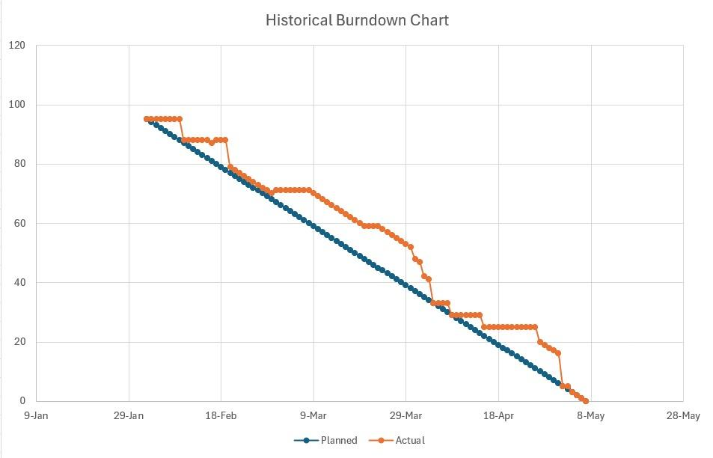
All Sprint Burndown chart

Slide 43
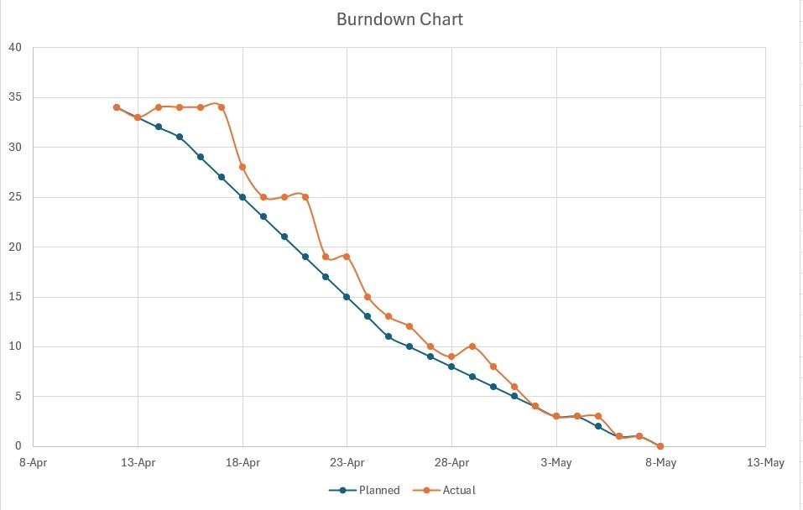
Burndown chart Sprint 4

Slide 44
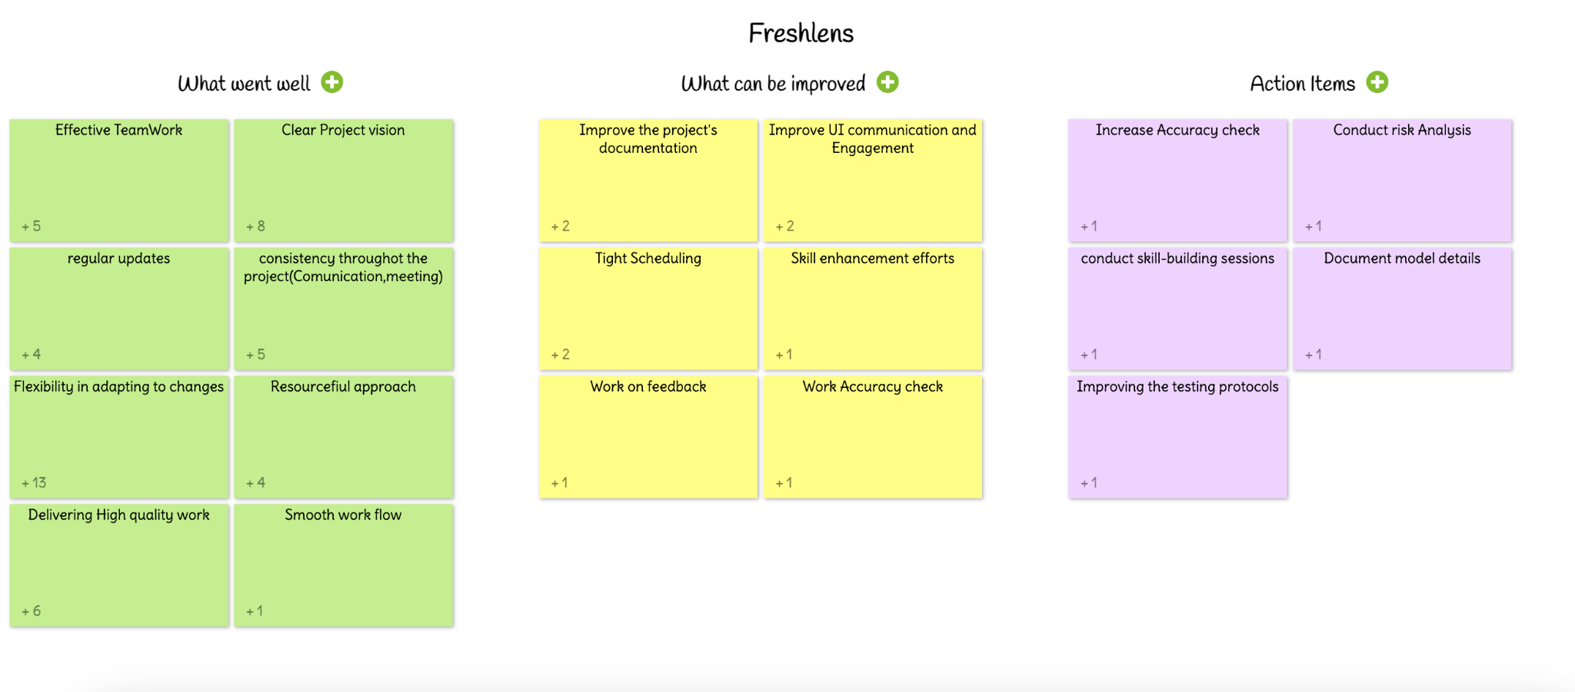
RETROSPECTIVE

Slide 45
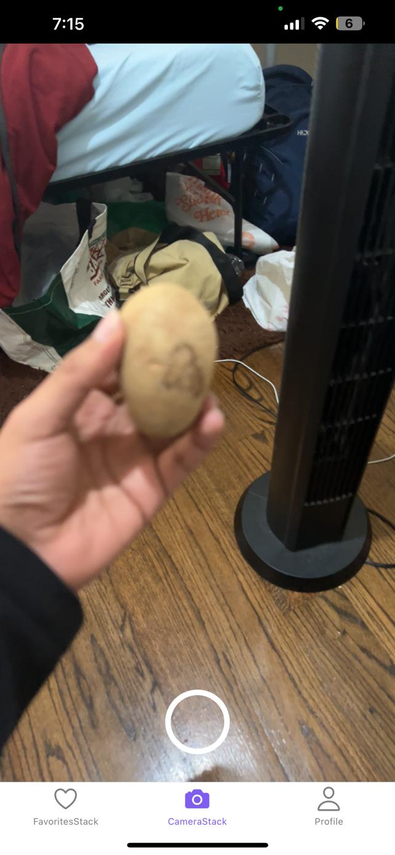
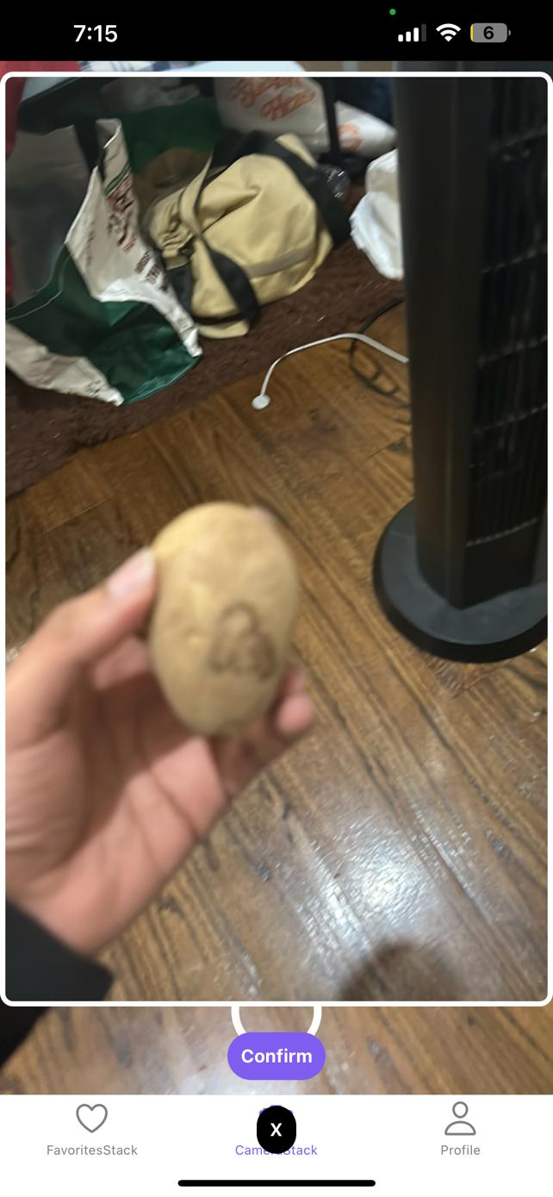
Demo Screenshots
Capture Modal
Favorite
Screen

Slide 46
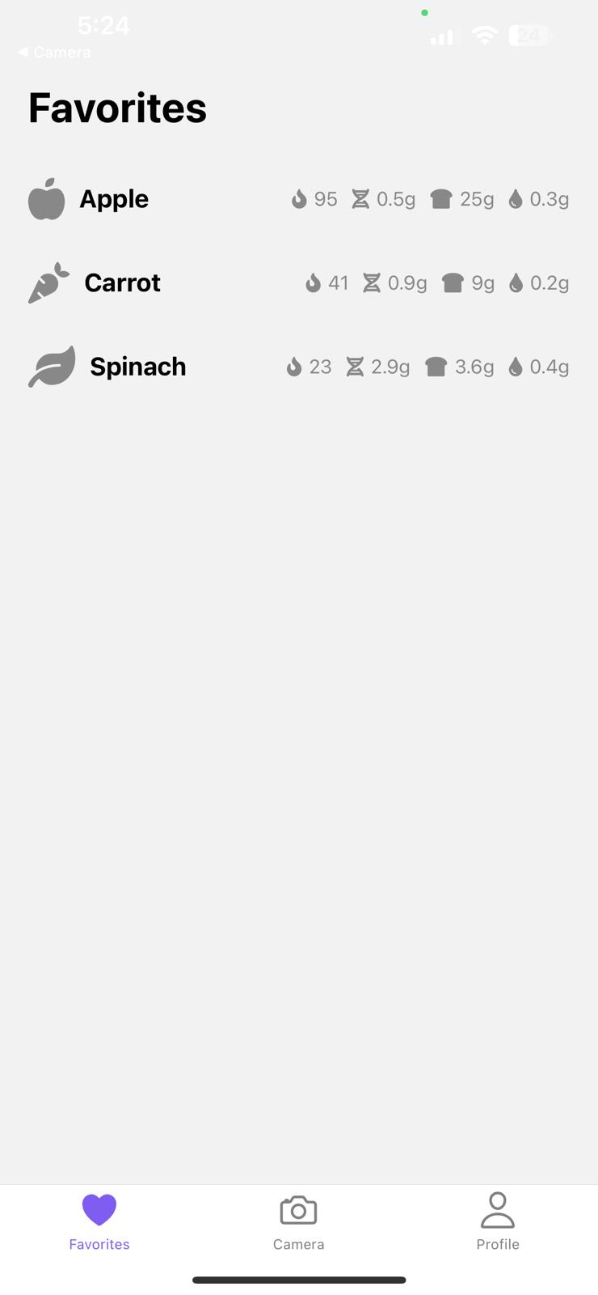
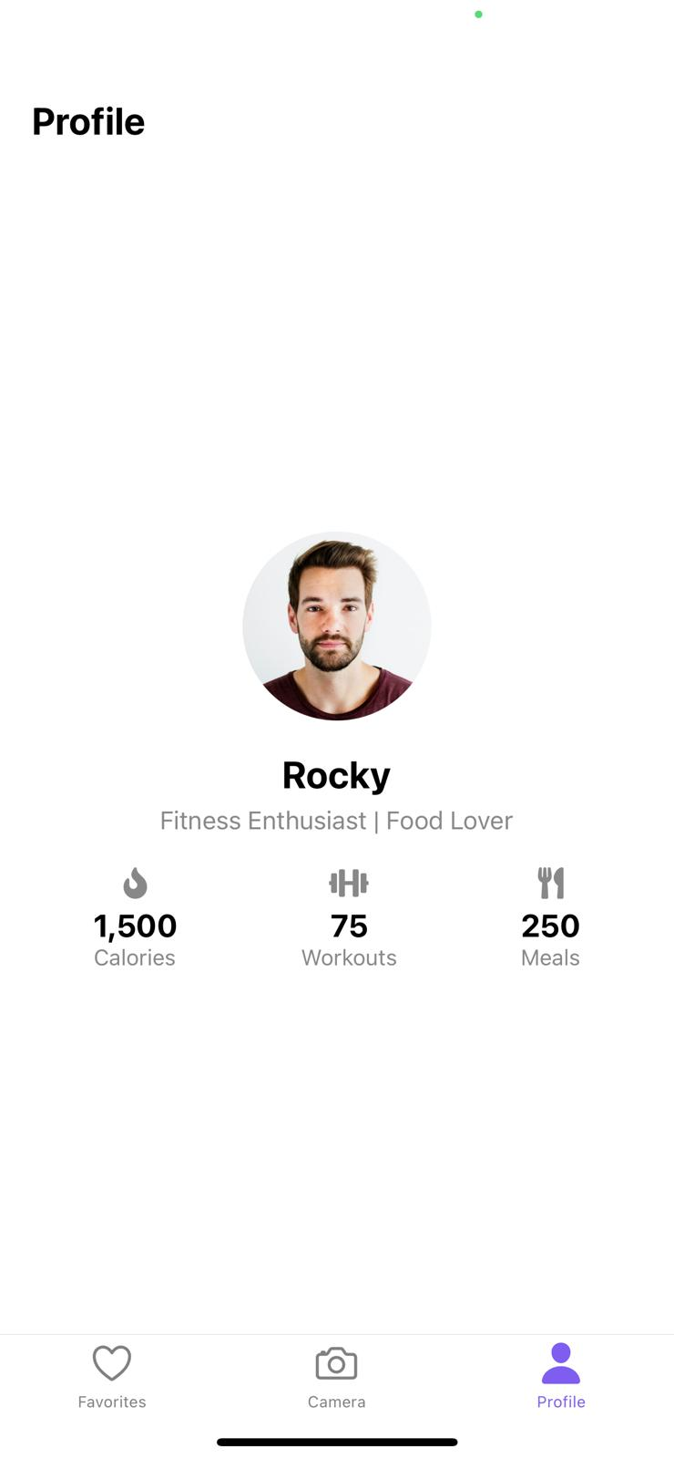
Demo Screenshots
Favorite
Screen
Profile Screen

Slide 47
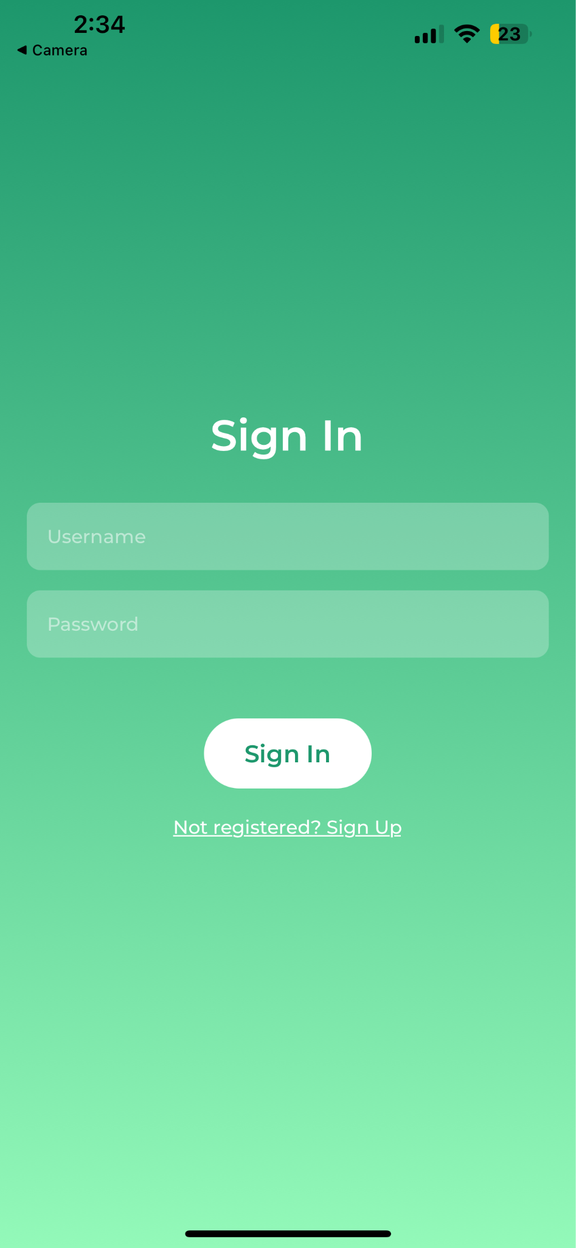
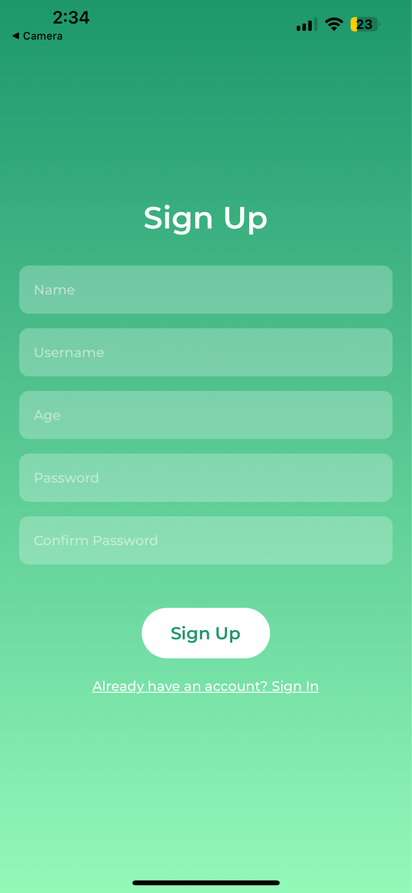
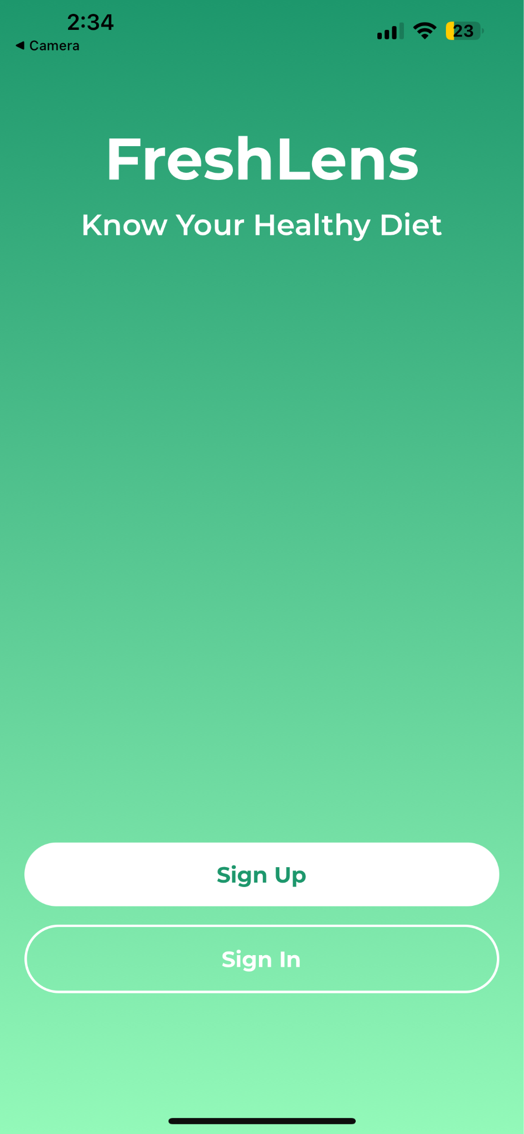
Demo Screenshots Auth Screen

Slide 48
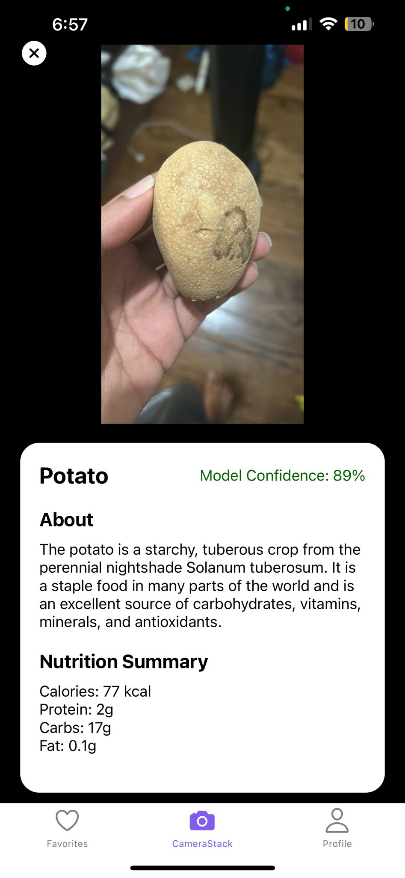
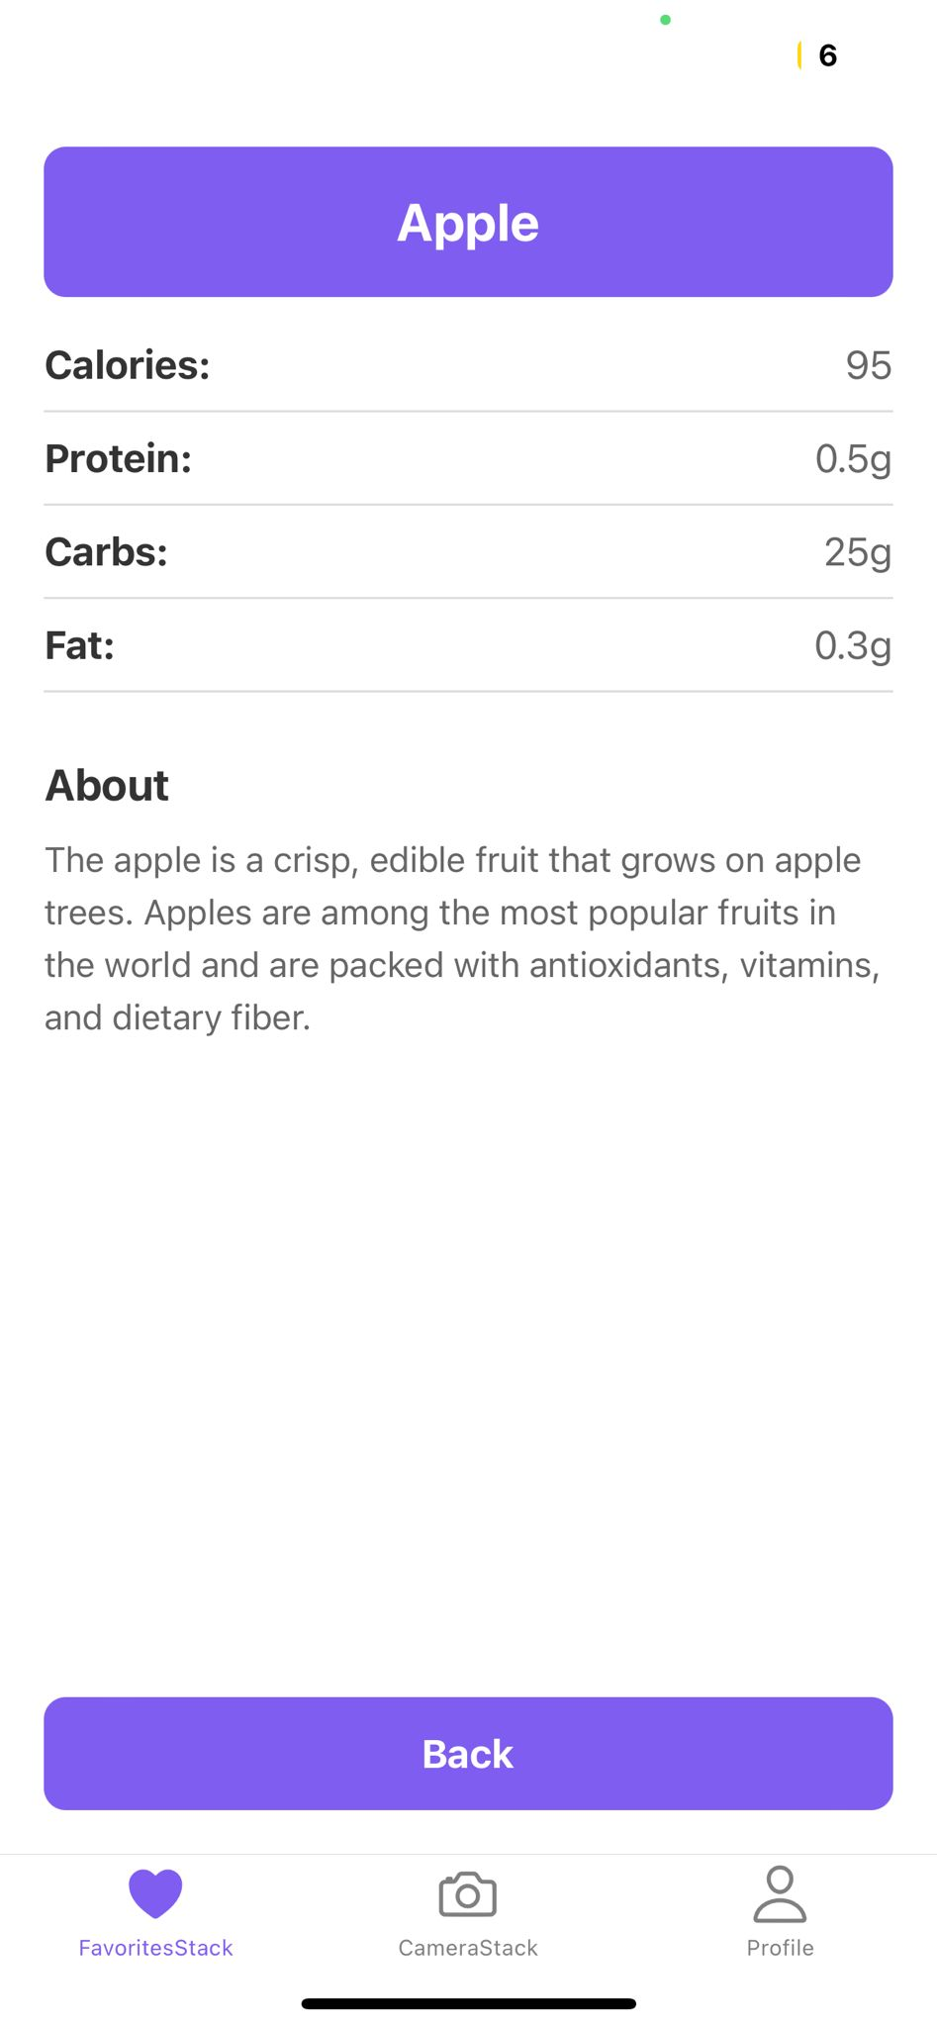
Application

Slide 49
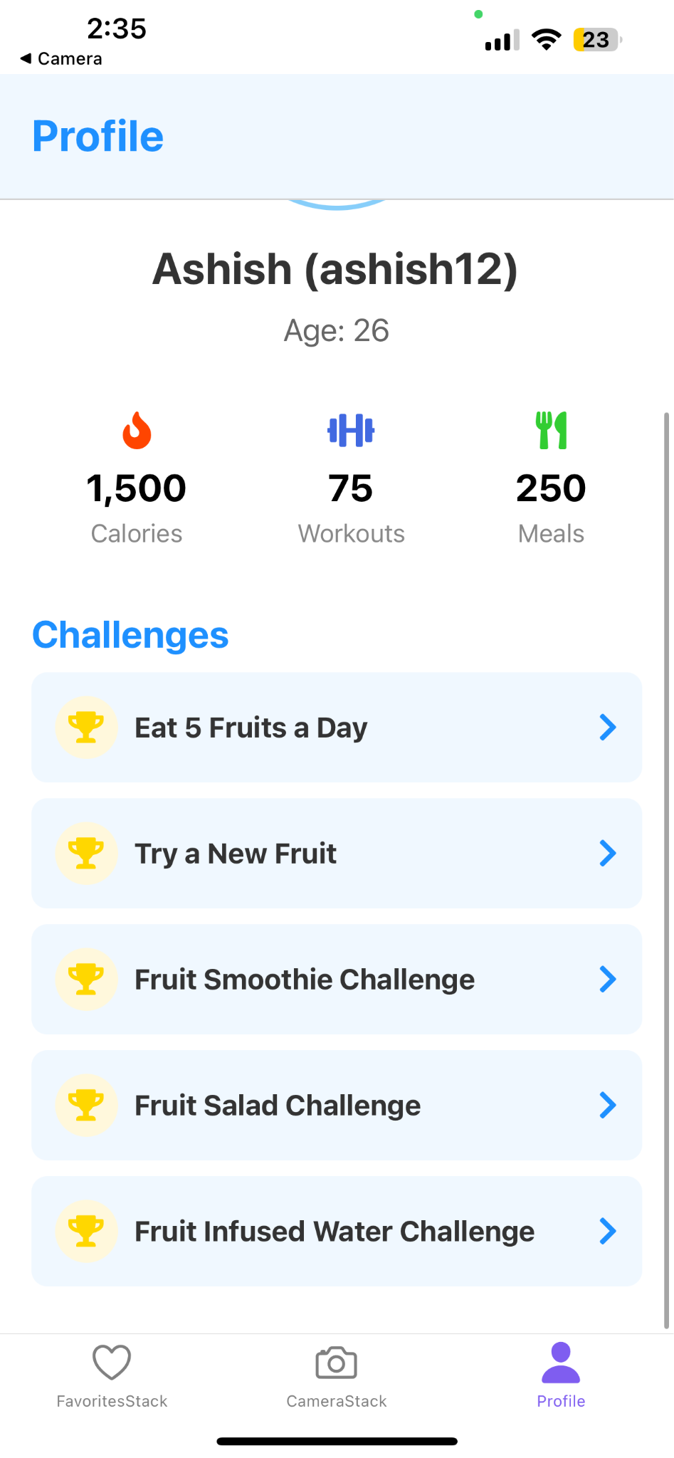
Demo Screenshots
Challenge Screen

Slide 50
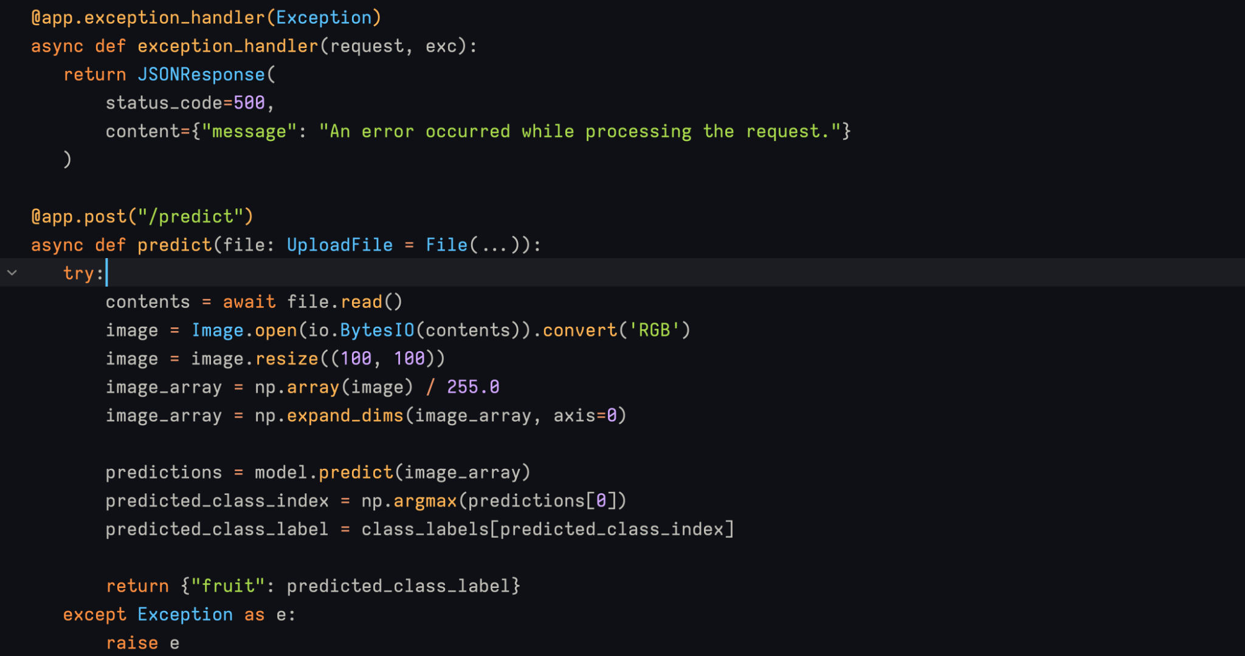
FastAPI

Slide 51
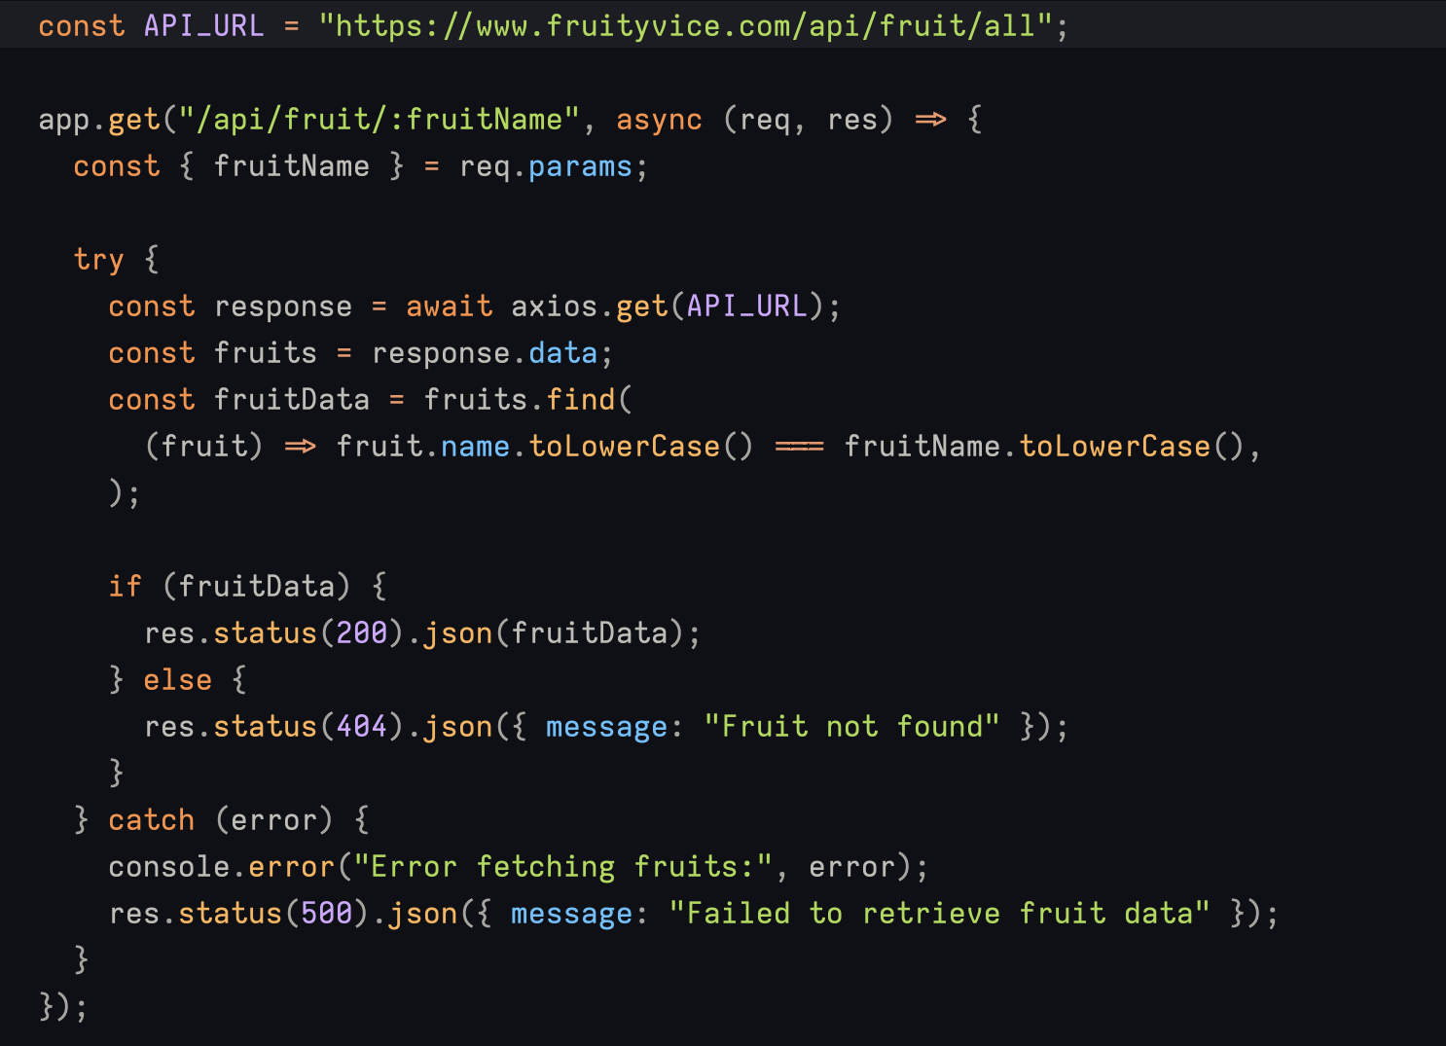
Node JS Api

Slide 52
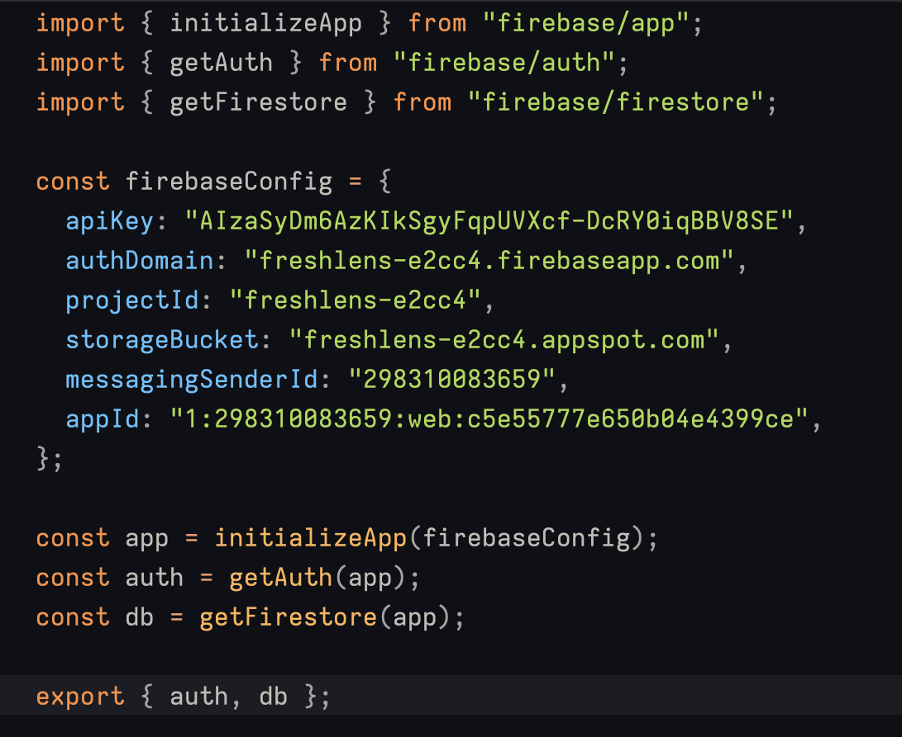
Firebase API

Slide 53
Wikipage link
https://github.com/htmw/2024S-Sierra/wiki

Slide 54
Application Demo

Slide 55
THANK YOU

